Slide 1

How to Improve SLA
By Bruno Magnani

Slide 2
How to improve SLA for tickets raised between 2018 - 2021
In this Presentation we will concentrate on all the Breached Tickets and try to find insights into how to improve SLA and reduce the number of days these tickets have breached by.
Overall, the best course of action is to speak to the respective teams to whom these tickets were assigned to and establish what factors contributed to their breach. These factors may consist of a lack of staff and training. This is the best way to find out why they have breached and then the respective Management Teams can implement a solution.
I decided to use a combination of parameters as a filter. By doing this, I was looking to find insights into why these tickets that had breached or point in a direction for further investigation.
First of all, we will look at the Tickets per Team Assigned showing the Subject and the Number of Working Days that they had breached by.

Slide 3
As we can see the highest number of breached tickets occurred for the JDE Support Team and the SAP Support Team encompassing the Java Software Development Environment and the SAP functionality across the Enterprise. The following data shows the tickets that have breached and their respective number of working days breached ranked from highest to lowest for each Team Assigned. If the number of days in breach is a negative number that particular ticket is in Breach.

Slide 4
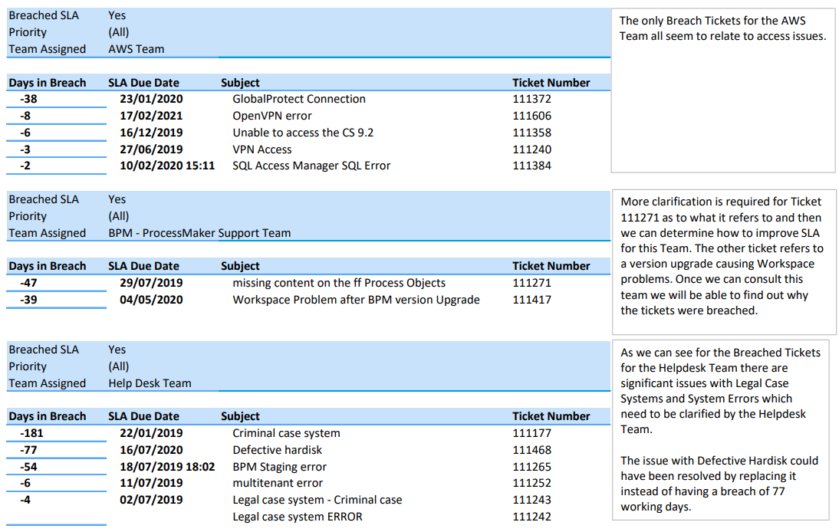

Slide 5
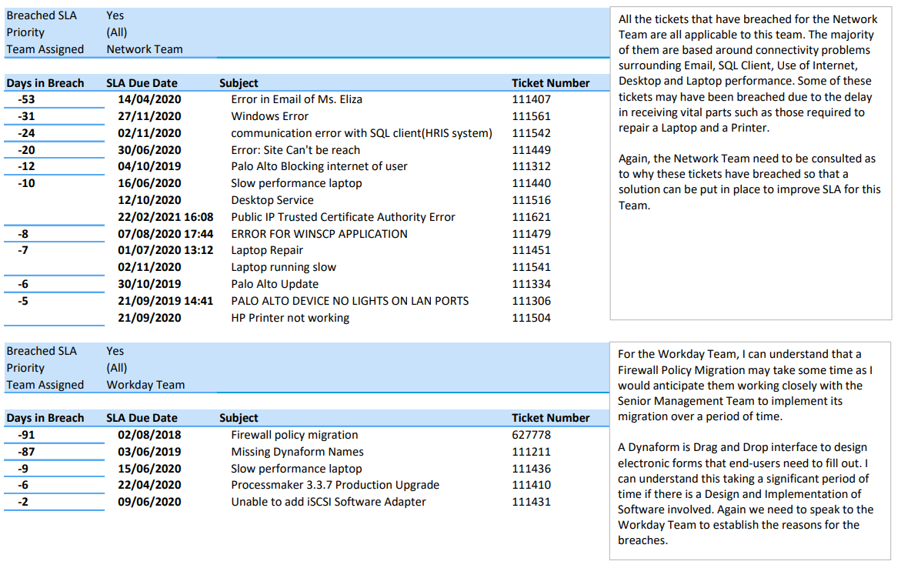

Slide 6
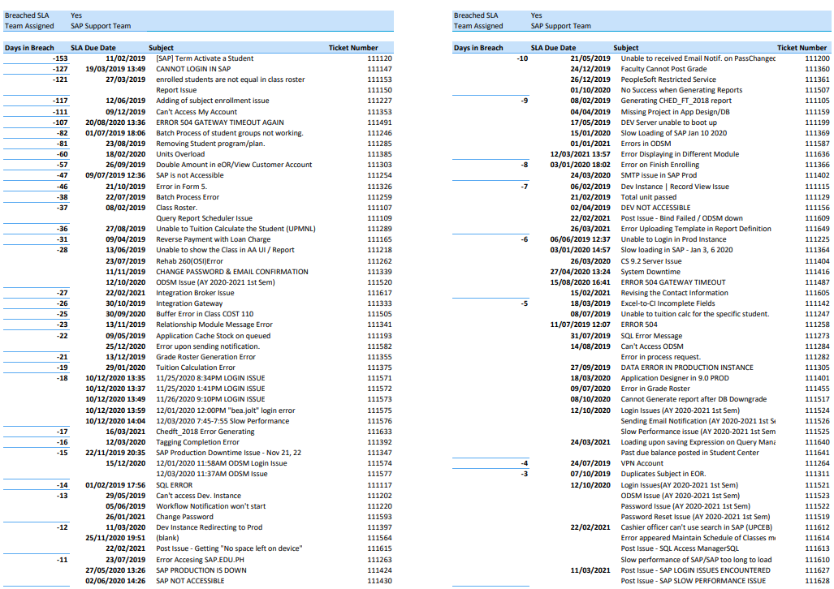

Slide 7
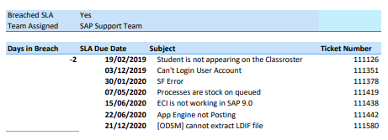

Slide 8
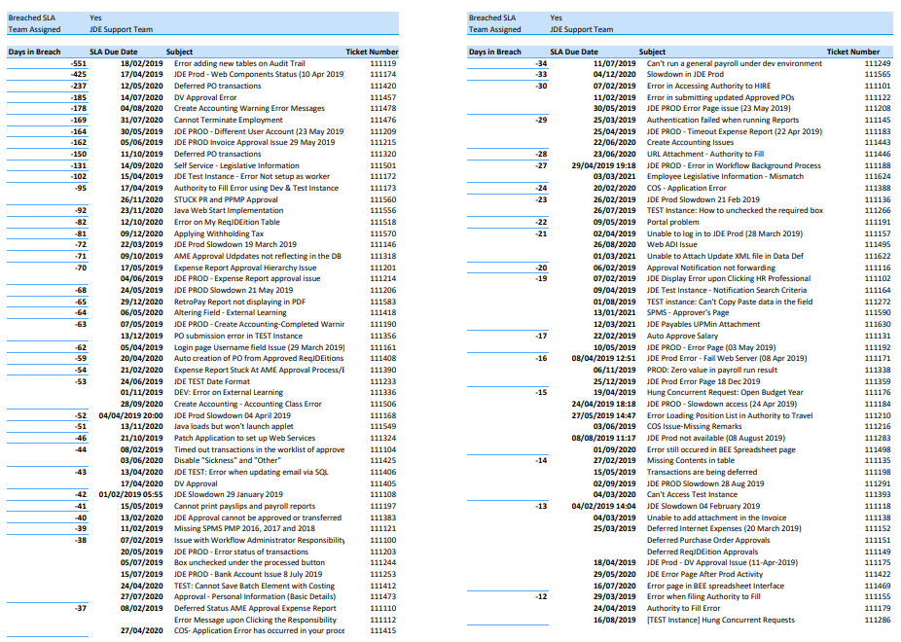

Slide 9
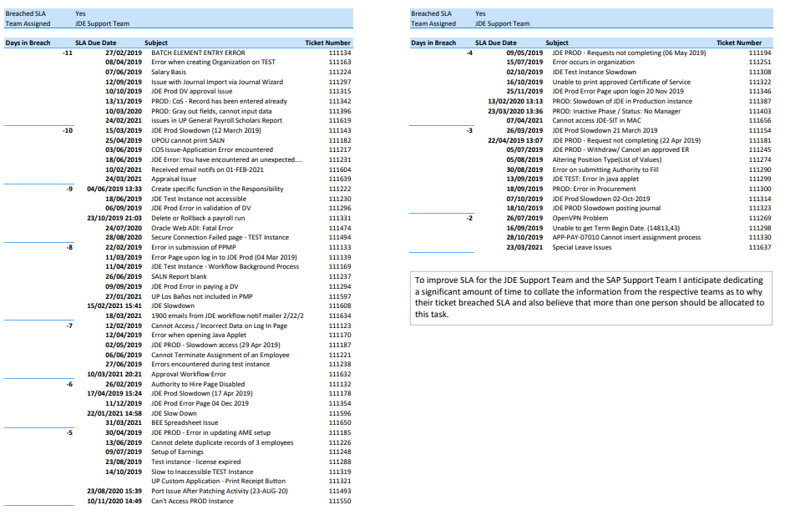

Slide 10
From the Bar Chart we can see that the number of breached tickets per agent assigned reveals an important insight that Agent Jared Smith has 266 tickets breached. The following data will show the number of working days that each of these tickets are in breach by and their respective Ticket Numbers, SLA Due Dates and Subject.

Slide 11
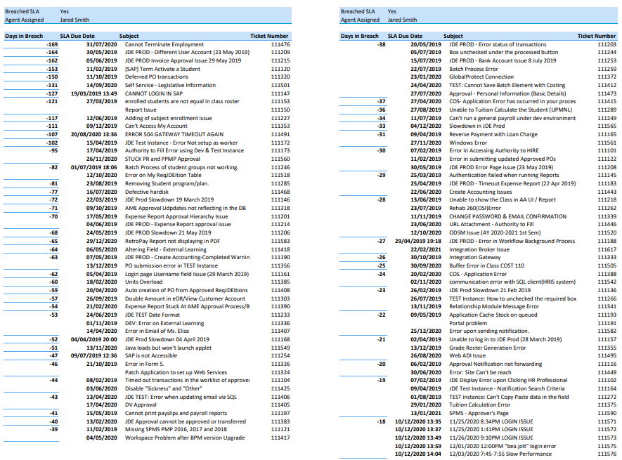

Slide 12
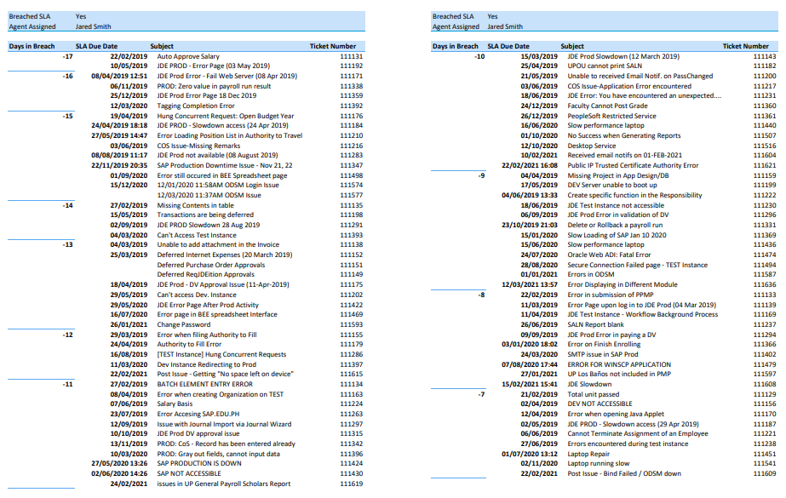

Slide 13
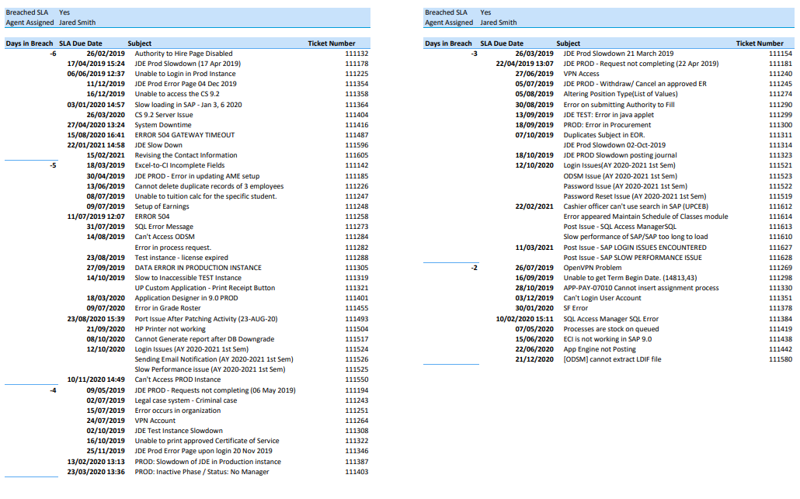

Slide 14
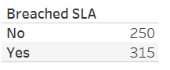
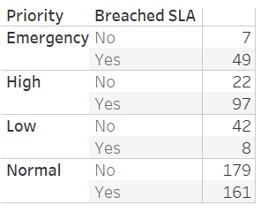
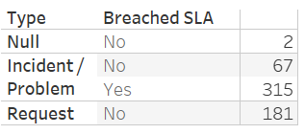
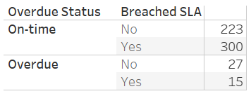
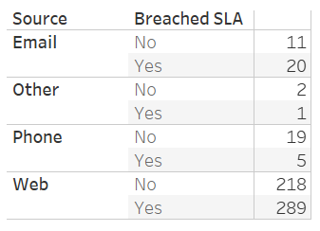
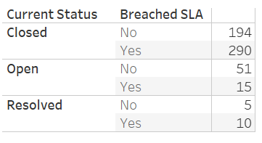
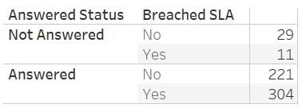
Number of Breached Tickets per Priority, Type, Overdue Status, Source, Current Status, Answered Status

Slide 15
There are a total of 315 Breached Tickets. By examining such tickets per Priority, I found that the number of tickets that breached increased as the priority decreased from Emergency through to Normal with the exception of the Low Priority. In addition to this, the ratio of Not Breached to Breached increased as the Priority decreased from Emergency to Normal. At the Normal Priority the percentage of Breached Tickets was 28.50% and the percentage of Non Breached Tickets was 31.68%, nearly in the ratio of 1:1.
If you look at the types of tickets that were breached, all the breached tickets in total were of type Incident/Problem.
As far as the Breached Tickets with Overdue Status are concerned, 300 tickets were classed as On-time but they breached the SLA criteria. This shows me that criteria for an On-time Status needs to be more aligned with the SLA.
If we look at the Source from which the tickets were received, 54.69% of them were received through a Digital Channel comprising of 51.15% and 3.54% being received through the Web and Email respectively.
With regard to the Breached Tickets by Current Status, 51.33% of breached tickets were of a Closed Status. We need to establish what is the difference between the Closed and Resolved Status.
I also looked at the Breached Tickets by Answered Status and the data shows that 53.81% of those that were answered were breached as opposed to 1.95% that were not answered. Those that were not answered were 11 tickets in total assigned to the JDE Support Team, the SAP Support Team and the Helpdesk Team.

Slide 16
SUMMARY
The best way to understand why these 315 tickets breached the SLA is to speak to the teams that these tickets were assigned to and then you can put the appropriate solutions in place to improve SLA. The JDE Support Team breached 173 tickets and the SAP Support Team breached 109 tickets.
The Agent Jared Smith breached 266 tickets assigned to him. We will need to understand why this has taken place and provide support to this agent to help him improve SLA in the future.
All the 315 tickets that breached SLA were of the Incident/Problem Type.
A vast majority of the tickets, being 95.22% of the total, were raised through digital channels of the Web and Email. Those that breached SLA were 54.69% of the total. I recognise that raising IT tickets digitally is the channel of choice for most organisations, however in this case, is there a problem with this service channel that we need to investigate further.
The criteria for on-time tickets needs to be more aligned to the SLA as they were classed as breaching SLA. In theory, if a ticket is on-time it should not breach SLA.

Slide 17
SUMMARY continued
6. There were 340 normal priority tickets in total of which 161 breached SLA. In this respect, you
would expect the percentage of breached tickets to be higher in the priority category that has
handled the most tickets.

